Slide 1

AI Hackathon Team Intelliplan

Slide 2
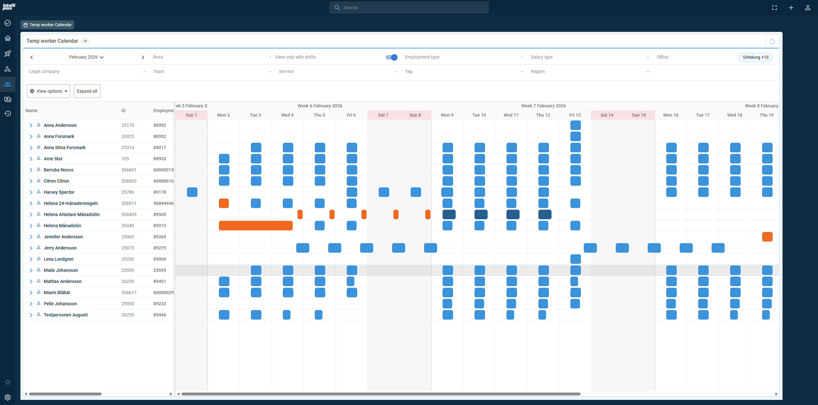
AI Hackathon
About Intelliplan
Intelliplan is an all-in-one cloud platform powering staffing agencies across the Nordics. By unifying CRM, ATS, staffing, payroll, and invoicing, we help teams move faster, work smarter, and run their operations with confidence.

Slide 3

AI Hackathon
Our Customers
Intelliplan is the market-leading staffing platform in Sweden, trusted by customers such as Manpower, Lernia, and Poolia.
22 of the 25 largest staffing agencies use one or more Intelliplan modules.
Our clients range from specialist staffing firms to high-volume recruitment and staffing providers, serving both blue-collar and white-collar industries.

Slide 4
AI Hackathon
Our Users
Internal users: Sales representatives, recruiters, talent agents, consultant/delivery managers and finance teams
External users: Customer ordering contacts (our customers’ customers), candidates and consultants
Each role is supported by tailored workflows and integrated tools that streamline daily work, improve collaboration and enable a seamless end-to-end process from candidate sourcing to invoicing

Slide 5
AI Hackathon
The Hackathon Challenge
AI-Powered Customer Portal Staffing customers operate in fast-paced, disruption-driven environments where staffing needs can change with very short notice. When changes occur, customers must reach out to their staffing provider, explain the situation, wait for analysis, and rely on manual coordination - often under time pressure (inside or outside of normal business hours). The core challenge is to enable fast, confident customer action without compromising quality, control or professional decision-making. While customers want speed and self-service, staffing providers must ensure the right competence, customer experience, and compliance in every decision.
Your Challenge Build an AI-powered customer portal that allows customers to express staffing needs in natural language and immediately receive qualified, transparent suggestions. The system should:
Interpret customer intent from unstructured input
Analyze availability, competence and quality risk
Present clear options and trade-offs
Keep the consultant/delivery manager in control of final decisions
The result should be a workflow where AI handles complexity, customers gain speed and consultant managers retain ownership of quality and relationships.

Slide 6



AI Hackathon
Personas
Johan Andersson
Age: 41 Company: Warehouse AB Role: Operation Manager
(5 yrs in industry)
Sara Lindqvist
Age: 38 Company: Staffing Agency Role: Delivery Manager
(12 yrs in industry)
Hanna Larsson
Age: 25 Role: Consultant
(3 yrs in industry)
Goals
Resolves acute staffing gaps quickly with minimal back-and-forth
Expresses staffing needs in plain language and gets immediate suggestions
Feels confident that suggested consultants can do the job
Frustrations
Stress when shifts are at risk of being understaffed
Waiting for responses from the staffing provider
Uncertainty around consultant quality and customer familiarity
Desired features
Chat-based interface for fast, natural requests
Clear, concrete suggestions of available consultants
Transparent explanation of risks (e.g. missing competence or customer experience)
Goals
Make fast, high-quality staffing decisions with confidence
Retains full control over which consultant is booked
Reduces manual coordination and repetitive decision-making
Frustrations
Becoming a bottleneck for simple staffing changes
Having to manually assess competence, availability, and customer fit
Lack of transparency in why certain consultants are suggested
Desired features
Pre-analyzed staffing suggestions with clear reasoning
Explicit quality and risk indicators
Simple approve / adjust / reject flows with full auditability
Goals
Receive relevant shift offers that match his skills and experience
Get clear, timely information about when and where to work
Feels fairly treated and confident in the booking process
Frustrations
Receiving shift requests she is not qualified for
Short notice without enough context
Uncertainty about whether responding quickly actually matters
Desired features
Clear, concise shift requests with role, time and location
Fast confirmation once a booking decision is made
Reminders when and where to work

